Slide 1
RECOMMENDER ENGINE OPTIMIZATION
STEVEN L TRUONG
Friday, 04/30/2021

Slide 2

Notes:
Fandor is a streaming platform for hardcore film lovers and they are currently a sub channel of amazon prime. They want to expand into an independently original program.

Slide 3
Become an independently original program
01

Slide 4
Become an independently original program
02
Optimize the recommender engine

Slide 5
Become an independently original program
03
Optimize the recommender engine
Reduce consumers churning rate

Slide 6
WHY?
WHY DO WE NEED TO IMPROVE THE RECOMMENDER ENGINE?

Slide 7
According to Deloitte, among customers who cancel the services
Motivation

Slide 8
According to Deloitte, among customers who cancel the services
62%
Motivation
ONE SPECIFIC SHOW THEN CANCEL

Slide 9
According to Deloitte, among customers who cancel the services
62%
21%
Motivation
ONE SPECIFIC SHOW THEN CANCEL
LACKS OF NEW CONTENT

Slide 10
According to Deloitte, among customers who cancel the services
62%
21%
27%
Motivation
ONE SPECIFIC SHOW THEN CANCEL
LACKS OF NEW CONTENT
STAY IF MORE EXCLUSIVE CONTENT

Slide 11
Solution?

Slide 12
Hypothesis and solution path

Slide 13
Pre-launch
Implement SOTA algorithms
01
Hypothesis and solution path

Slide 14
Pre-launch
Implement SOTA algorithms
01
02
Pre-launch
Measure errors and A/B testing the engine
Hypothesis and solution path

Slide 15
Pre-launch
Launch
Implement SOTA algorithms
Reduce the churning rate by 10%
01
02
03
Pre-launch
Measure errors and A/B testing the engine
Hypothesis and solution path

Slide 16
Pre-launch
Launch
Implement SOTA algorithms
Reduce the churning rate by 10%
01
02
03
04
Pre-launch
3-month
Measure errors and A/B testing the engine
Reduce churning rate by 20%
Hypothesis and solution path

Slide 17
Data
EDA/Visualization
Language
Acquire from MovieLens website
Google Sheet and Tableau
Python, SQL, HTML, CSS
Packages
API
Deployment
surprise, numpy, pandas, requests
The Movie Database API
Flask, SQLAlchemy
Data and tools

Slide 18
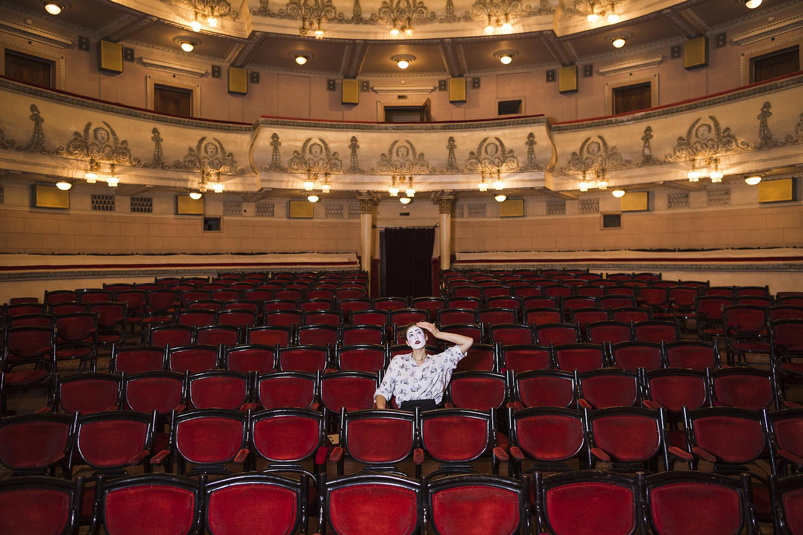
HOW DO WE APPROACH THE PROBLEM?

Slide 19
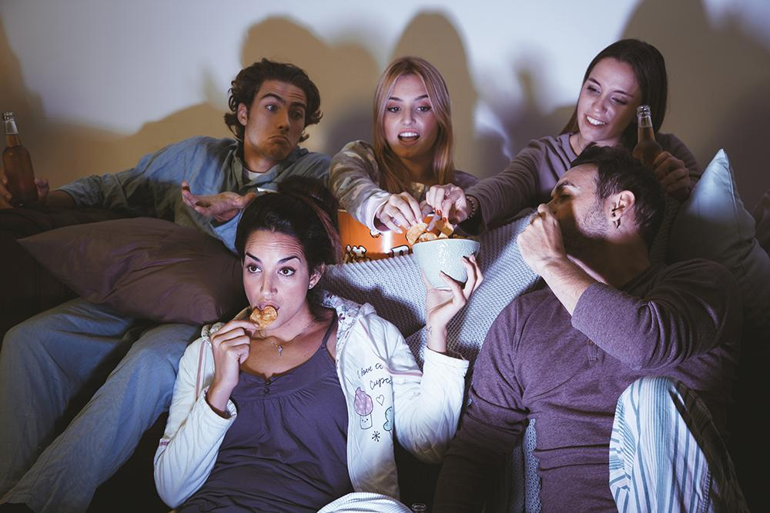
Approach
01
User-based collaborative filtering. Recommend similar movies based on user’s preference.

Slide 20

Approach
02
Item-based collaborative filtering. Recommend similar movies based on its characteristics.

Slide 21
Results

Slide 22
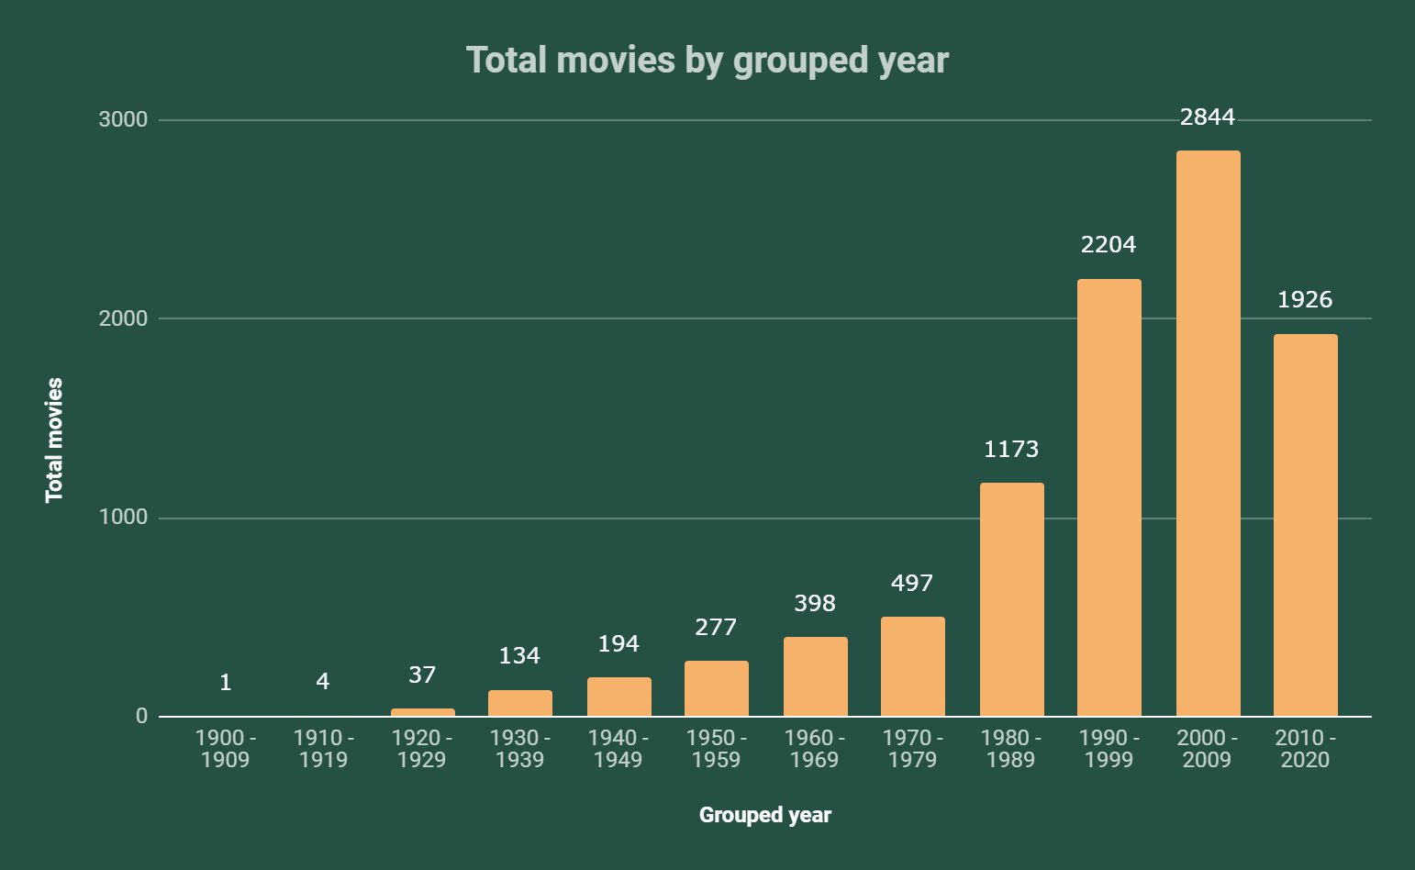
Total movies by decade

Slide 23
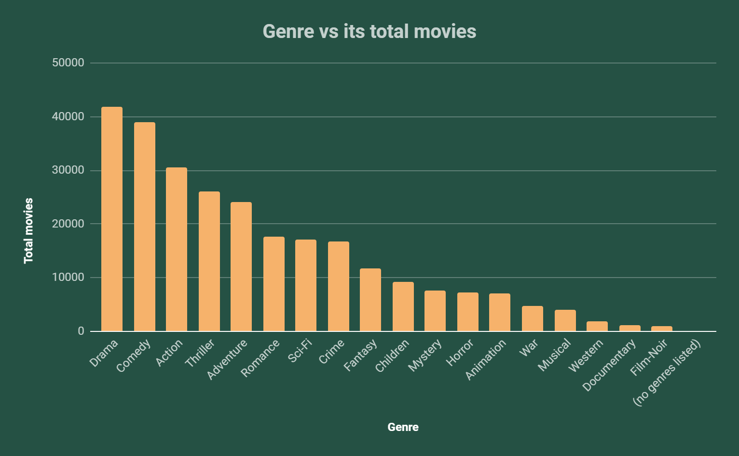
Total movies by genre

Slide 24
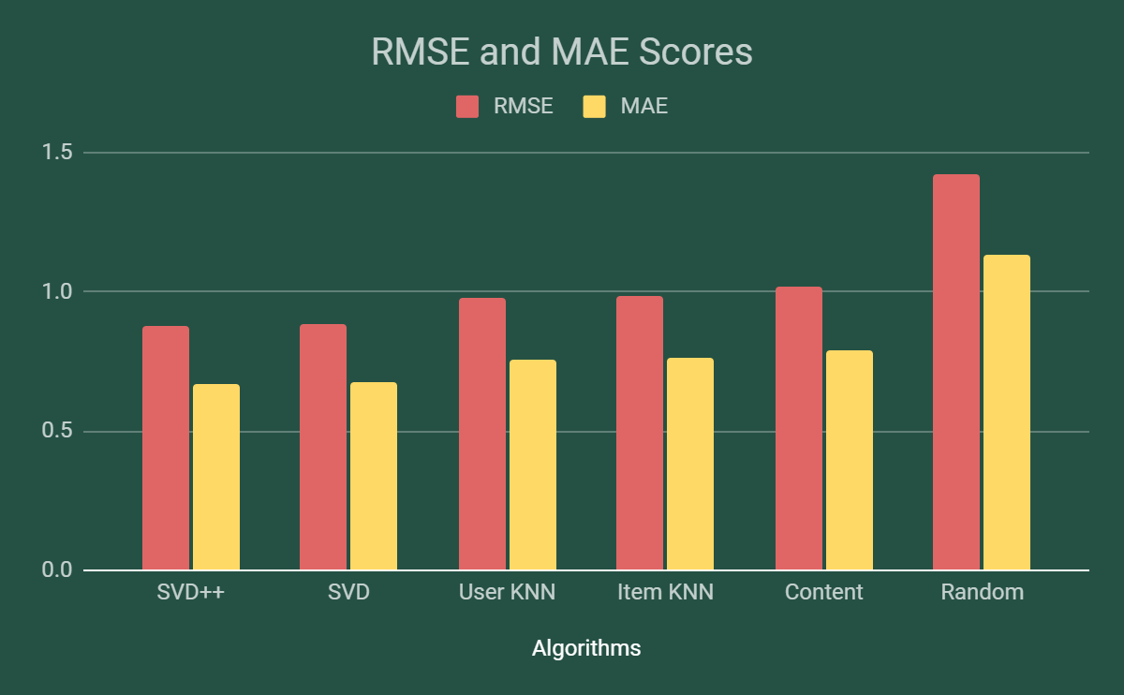
The lower the score, the better the algorithm

Slide 25
Demo

Slide 26
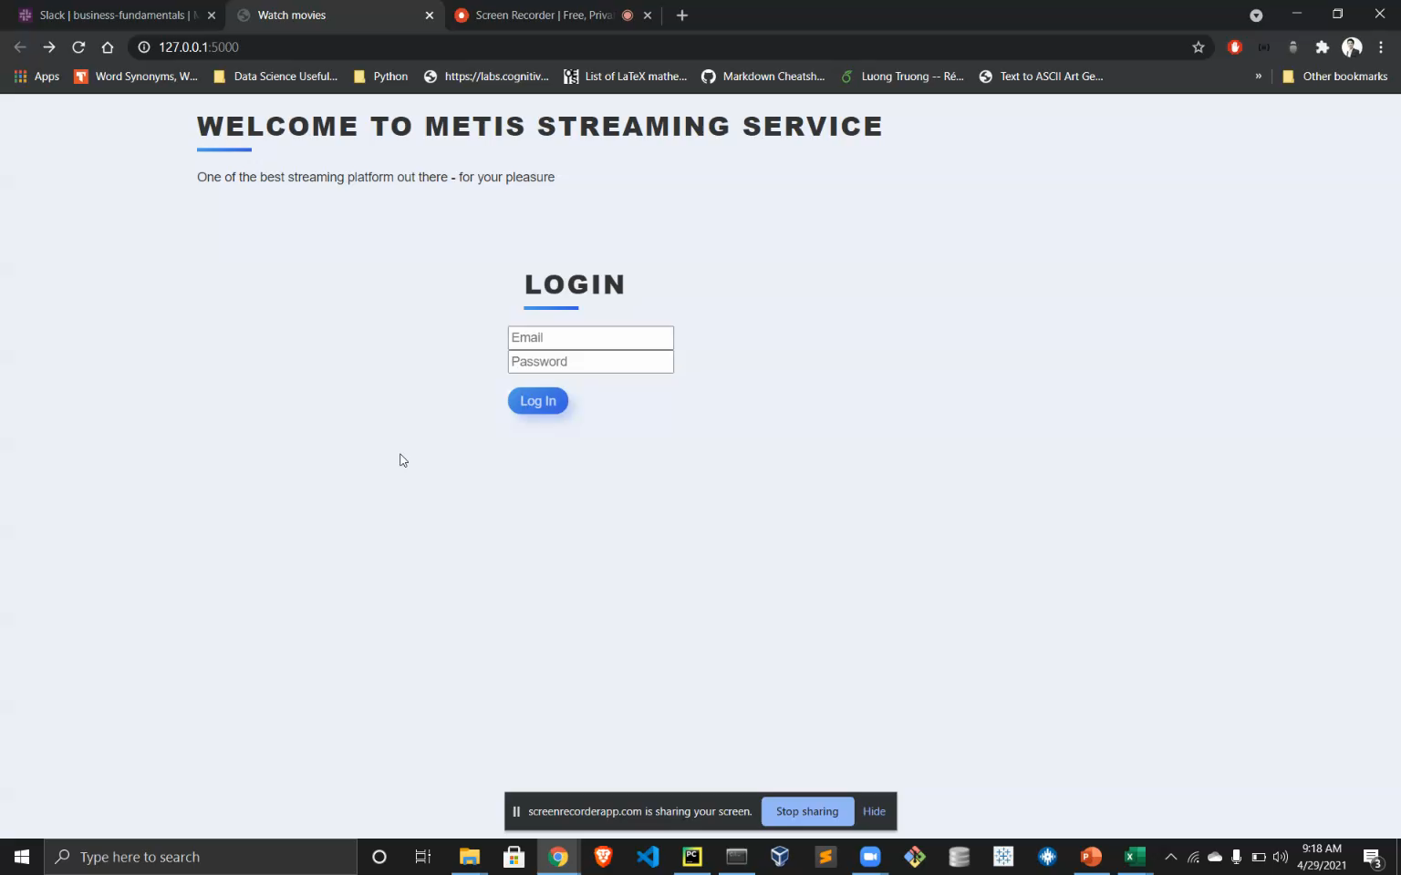

Slide 27
Future Work
Algorithm
Data
Restricted Boltzmann Machines (RBM’s) Deep Neural Networks (RNN) Tensorflow Recommenders (TFRS) NLP
Scale it up using Apache Spark Amazon Deep Scalable Sparse Tensor Network Engine (DSSTNE)

Slide 28
Thank you!
STEVEN L TRUONG
https://github.com/luongtruong77
https://www.linkedin.com/in/luongtruong77/

Slide 29
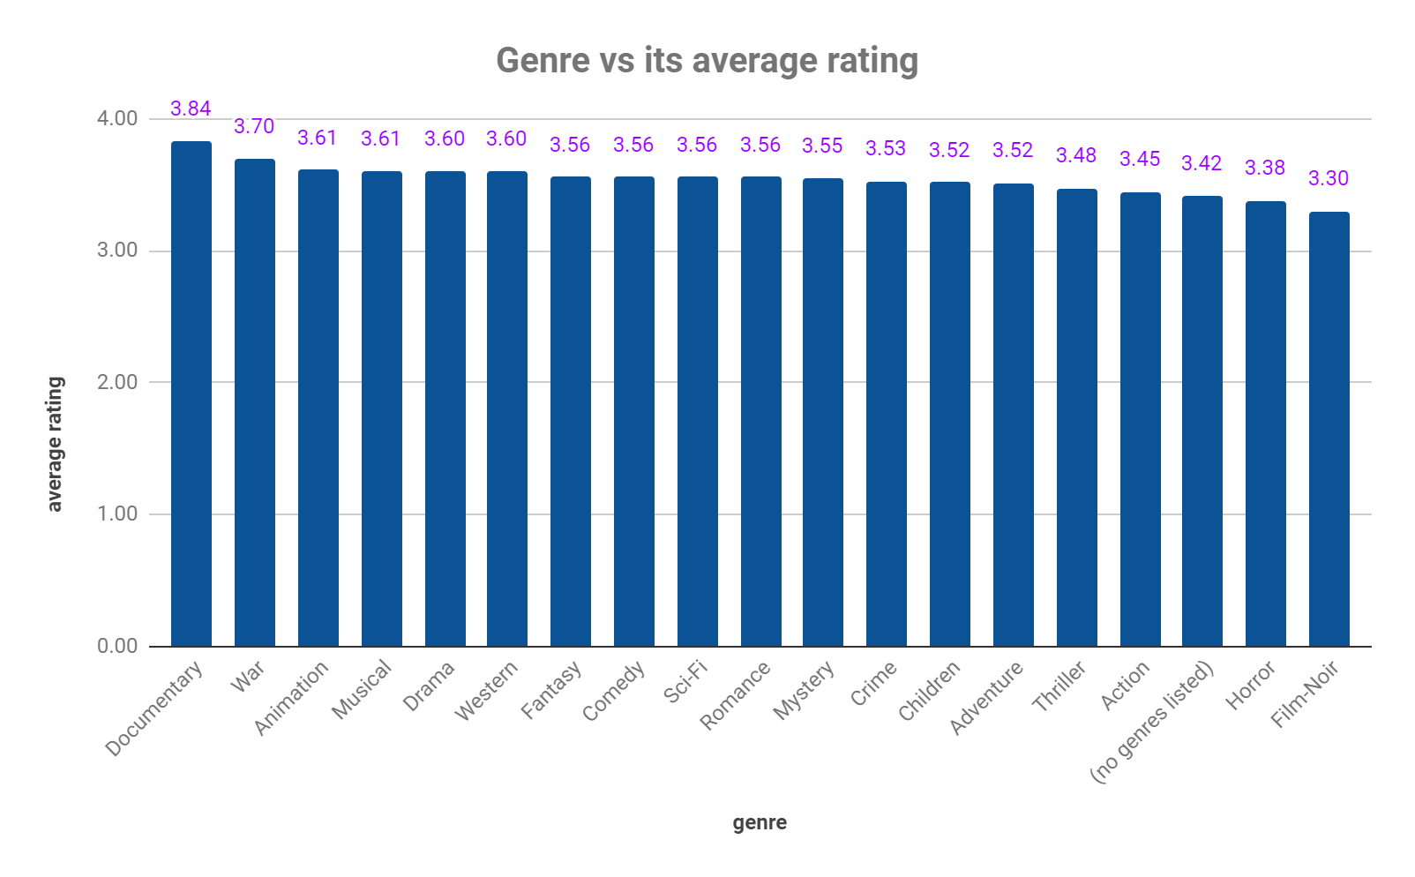
Average rating by genre
Appendix
The Documentary genre has the highest average rating, followed by War and Animation. Horror and Film-Noir have the lowest rating of all.

Slide 30
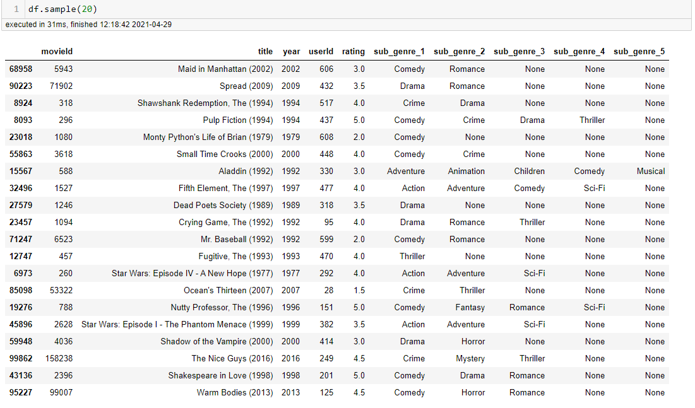
20 random rows from over 100,000 rows
Appendix
Each movie has one or more genres associated with it. For example, Aladdin (1992) is considered “Adventure | Animation | Children | Comedy | Musical” movie whereas Dead Poets Society (1989) is just a Drama.

Slide 31
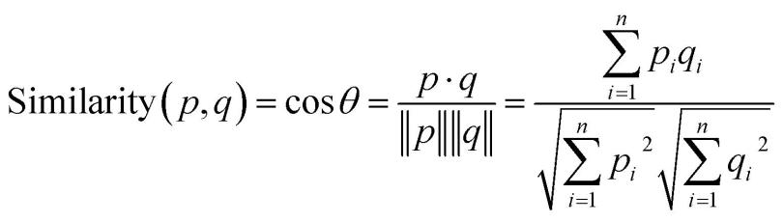
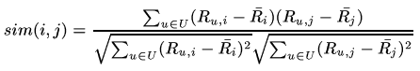
Cosine similarity (top) and adjusted cosine similarity (bottom) formulas
Appendix
We use cosine similarity to measure the similarity between movies (they are identical if `alpha` is 0 degree and totally different if `alpha` is 90 degree.

